Slide 1

Today!
Chapters We Covered
Study Materials + Past Exams
Practice Questions + Answers

Slide 2
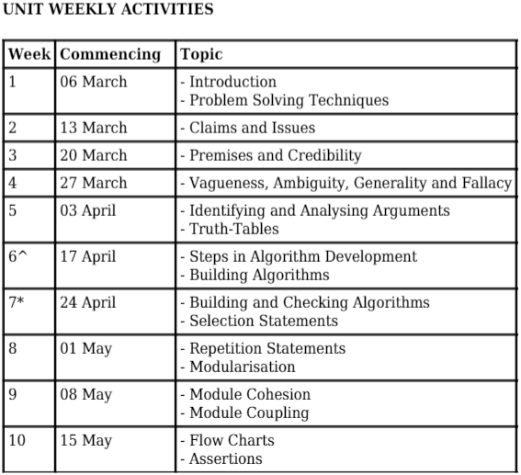

Topics We Covered

Slide 3
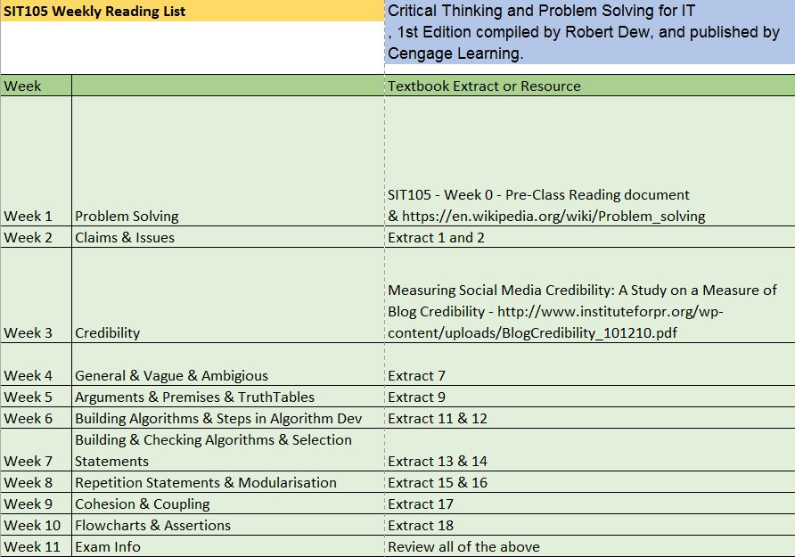
Chapters We Covered

Slide 4
MCQ
_______________ refers to what a module must achieve and if any _____________ is false, that module has failed to carry out its tasks.
A) Pre-condition
B) Post-condition
C) Pre-adaption
D) Post-cohesion

Slide 5
MCQ
Which of the following could be considered to be an issue of the claim ‘Texas Instrument created the world’s most delicated sensors’?
A) How does Texas Instrument program the circuits of the sensors?
B) Is Texas Instrument in responsible for creating the world’s delicated sensors?
C) What happens when one of Texas Instrument sensors don’t function well?
D) Texas Instrument was leading the market of sensors.

Slide 6
MCQ
___________ is a Boolean expression at a specific point in a program which will be true unless there is a bug in the program?
A) Operator
B) Adaption
C) Assertion
D) Formula

Slide 7
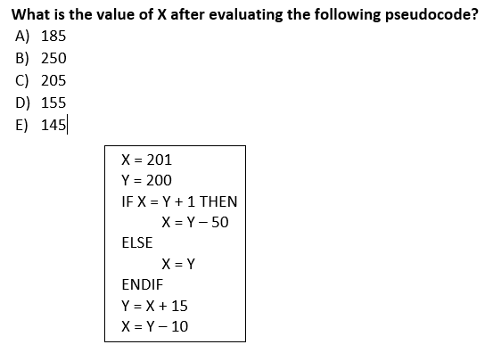
Practice Questions and Answers Short Answer

Slide 8
Practice Questions and Answers Short Answer
For the following algorithm, copy that algorithm but also include 3 assertions throughout.
X = 30
Y = 50
IF (X > 20 AND X < 50) OR X > 0 THEN
X = 0
ELSE
X = 50
Y=100
ENDIF

Slide 9
Practice Questions and Answers Short Answer
X = 30
Y = 50
Assert(X > 0 and X<=30)
IF (X > 20 AND X < 50) OR X > 0 THEN
X = 0
Assert(X >= 0 and X<300)
ELSE
X = 50
Assert(X=50)
Y=100
Assert(Y>50)
ENDIF

Slide 10

Question Time Good Luck !

